Slide 1

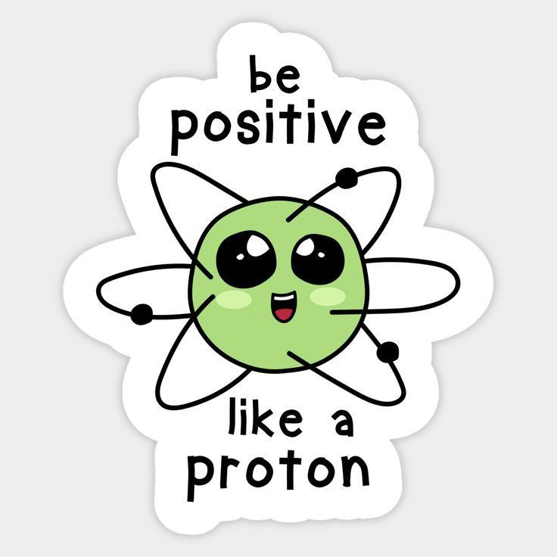


SMART INDIA HACKATHON 2025
TITLE PAGE
Problem Statement ID – 25092
Problem Statement Title- Development of a Digital Mental Health and Psychological Support System for Students in Higher Education
Theme- Medtech/BioTech/Health Tech
PS Category- Software
Team ID-
Team Name (Registered on portal)

Slide 2

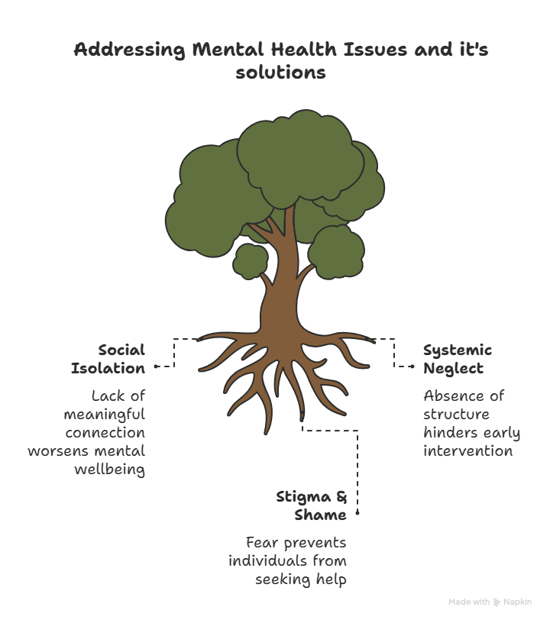



IDEA TITLE
TECH ARSENAL
Unique aspects
New generation-oriented working and interface.
Uses an AI/ML first aid chat system for instant relief.
Instant games to relieve stress or slight symptoms of anxiety, etc.
Peer chat groups, AI, and volunteer first aid chat
College integration and all-inclusive early detection
Competitive Advantage
System to provide data to the admin without disclosing the identity, while keeping it dependable.
First to provide mental health help in more than 13 languages
Anonymity

Slide 3
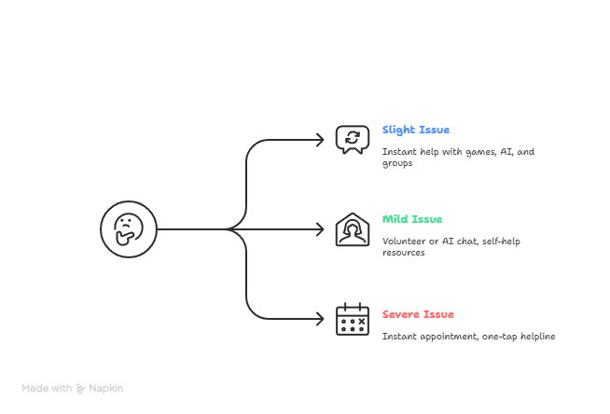

TECHNICAL APPROACH
TECH ARSENAL
Technologies
AI/ML Algorithms for chatbot NLP, mood/sentiment detection, and early risk flagging.
Authentication & Privacy Layer using JWT +encryption to ensure stigma-free, confidential access.
Cloud Deployment (AWS/GCP) with Docker/Kubernetes for scalability and high availability.
The college collects data without the name
Illness-related test
Log in with your college ID
General Mental Health Test

Slide 4

FEASIBILITY AND VIABILITY
TECH ARSENAL
FEASIBILITY
Challenges
Scalable Infrastructure: Designed for scalability using cloud computing and decentralized storage solutions.
Resilience towards culture: Being a multi-language, institute incorporated, new-gen based system, its scaled to include everyone.
Partnership with institutes: Having integrated with institutes will help them take actions regarding the same while being able to research the best course of action.
Cost-effective: Using AI/ML for self-learning, volunteer program, the cost of maintenance is significantly reduced.
Trust in the Institution: Students may be wary of the college itself having access to their mental health data.
Variable requirement: different regions and institutes require different systems and courses of action, along with following different rules according to the region.
Data Security: Need for robust encryption, secure servers, and regular security audits to prevent data breaches.
Accuracy of AI Chatbot: AI must provide safe, reliable responses and avoid misguiding users.
Resource Availability: Making sure enough counsellors and support staff exist to meet demand.

Slide 5

IMPACT AND BENEFITS
TECH ARSENAL
Impact on the Users
Benefits of the solution
24/7 Availability: Less feeling of loneliness and help at odd times, when a person is more vulnerable
Early Detection and support: It will be a step towards a healthy generation, as early detection means easier to cure and less harm.
No Language Barrier: Language barrier has been an obstacle for a long time but providing help in native languages will help a wider audience.
Promotes a culture of openness towards this serious issue and a community to share experiences with.
Strengthens student-institution trust, while providing both with the resources they need.
Low-cost, scalable digital solution.
Remote support lowers travel needs and increases accessibility for students in rural areas.

Slide 6
RESEARCH AND REFERENCES
TECH ARSENAL
World Health Organization- World Mental Health Today, 2 September 2025
https://www.who.int/publications/i/item/9789240113817
Tele MANAS App- by the government of India

